Slide 1
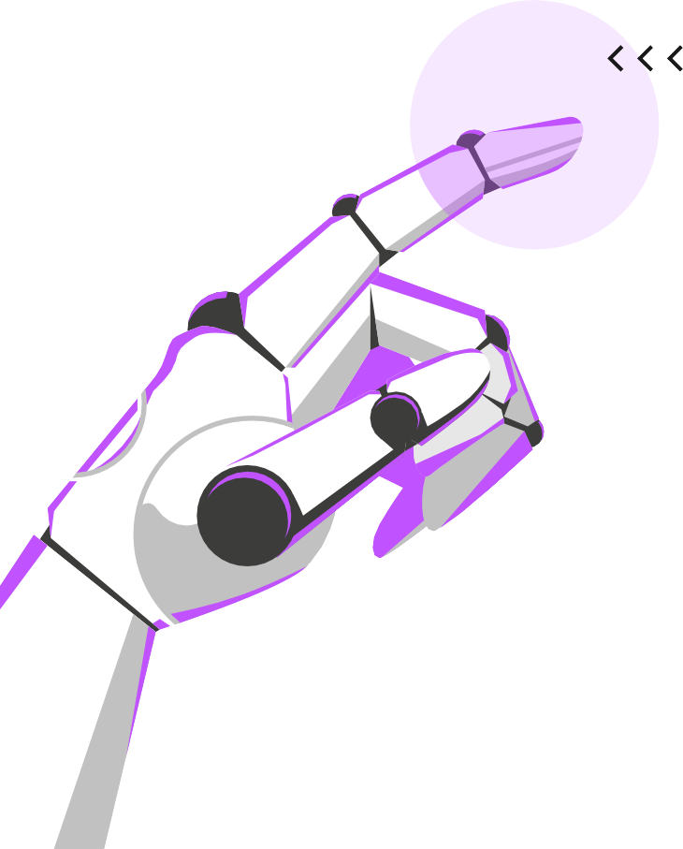
I)
I)
A A A
RTIFICIAL INTELLIGENCE (A
RTIFICIAL INTELLIGENCE (A RTIFICIAL INTELLIGENCE (A
PERsONALITY PREDICTION sYsTEM
DSE Mini Project
Bhakti Agrawal - 23
Akshat Jain – 09
Arnav Mukherjee – 19
Tanvi Kariappa – 56
Apoorva Athalye – 18
Anadi Desai - 28
I)
ARTIFICIAL
IGENCE (AI)

Slide 2
TABLE OF CONTENTS
01.
INTRODUCTION
02.
DATAsET USED
03.
METHODOLOGY
04.
REsULTs & DISCUssION
06.
REFERENCEs
05.
CONCLUsION
A
L
I)
RTIFICIA
INTELLI
GENCE (A

Slide 3
PROBLEM STATEMENT
ARTIF INTEL (AI)
ICIAL LIGENCE
"Developing an accurate and eﬃcient personality prediction system that analyzes user behavior and characteristics to anticipate and categorize personality traits, providing valuable insights for personalized user experiences in various applications such as online platforms, social media, and
human-computer interaction."

Slide 4
I NTRODUCTION
01.
/(AI)

Slide 5
PERsONALITY PREDICTION UsING AI
A A
LLIGENCE (AI) LLIGENCE (AI)
RTIFICIAL INTE
RTIFICIAL INTE
1. Objective:The Personality Prediction System aims to leverage Artiﬁcial Intelligence (AI) and Machine Learning (ML) to accurately forecast individual personality traits.
2.Data-driven Approach: By analyzing diverse data sources, including social media activities and text interactions, the system employs advanced ML algorithms to discern patterns and make predictions about an individual's personality.
3.Applications: The system's potential applications span various domains, such as personalized recommendations, mental health assessments, and human resources, oﬀering a novel approach to understanding and predicting human behavior.

Slide 6
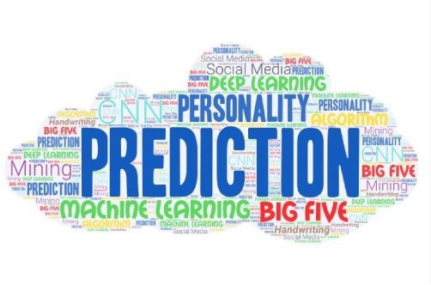
ARTIFICIAL INTELLIGEN
CE (AI)

Slide 7
DATASETS USED
/(AI)
02.

Slide 8
LLIGENCE (AI) LLIGENCE (AI)
PERsONALITY TRAITS DATASET
The Myers Briggs Type Indicator (or MBTI for short) is a personality type system that divides everyone into 16 distinct personality types across 5 axis:
Openness
Neuroticism
Conscientiousness
Agreeableness
Extraversion
A A
RTIFICIAL INTE
RTIFICIAL INTE

Slide 9
/(AI)
03.
METHODOLOGY

Slide 10


STEPS
/(AI)/(AI)/
/(AI)/(AI)/
DATA COLLECTION
SPLITTING DATA
PREPROCEssING
SELECTING BEsT MODEL
TRAIN THE MODEL
TEsT THE MODEL

Slide 11
ARTIFICIAL
INT (AI)
ELLIGENCE
D A T A C O L L E C T I O N
Gather a diverse and comprehensive dataset
comprising user information, social media activities, textual data, and other relevant features.
Ensure the dataset is representative of various
personality traits and demographics to enhance the model's generalizability.
(AI)

Slide 12
ARTIFICIAL
INT (AI)
ELLIGENCE
Preprocessing
Cleanse the dataset by handling missing values, removing noise, and standardizing formats.
Apply text preprocessing techniques for textual data, including tokenization, stemming, and removing stop words.
Normalize numerical features to bring them to a consistent scale.
(AI)

Slide 13
ARTIFICIAL
INT (AI)
ELLIGENCE
SPLITTING THE DATA
Divide the dataset into training set and testing set.
To evaluate model performance accurately.
(AI)

Slide 14
ARTIFICIAL
INT (AI)
ELLIGENCE
SELECTING THE BEsT MODEL
Explore various machine learning algorithms suitable for classiﬁcation tasks, such as Support Vector Machines, Decision Trees, Random Forests, or Neural Networks.
Evaluate diﬀerent models based on performance metrics and choose the one that best suits the characteristics of the dataset.
(AI)

Slide 15
ARTIFICIAL
INT (AI)
ELLIGENCE
TRAIN THE MODEL
Split the dataset into training and validation sets.
Train the selected model on the training set, adjusting hyperparameters as needed.
Validate the model on the separate validation set to assess its generalization performance.
(AI)

Slide 16
ARTIFICIAL
INT (AI)
ELLIGENCE
TEsT THE MODEL
Evaluate the model's performance using metrics like accuracy, precision, recall, and F1 score.
Conduct cross-validation to ensure the model's robustness across diﬀerent subsets of the data.
(AI)

Slide 17
REsULTs AND DIsCUssION
/(AI)
04.

Slide 18
Box-and-Whiskers Plots: Outliers were identiﬁed in the conscientiousness trait, warranting further investigation.
Heatmap Analysis: Strong positive correlation observed between extraversion and openness personality traits.
Model Training Time: SVM training time: 15 minutes on a standard machine, indicating a computationally eﬃcient process.
Generalization Capability: The SVM model exhibited a strong ability to generalize, performing well on the testing set with minimal overﬁtting.
/(AI)/(AI)/

Slide 19
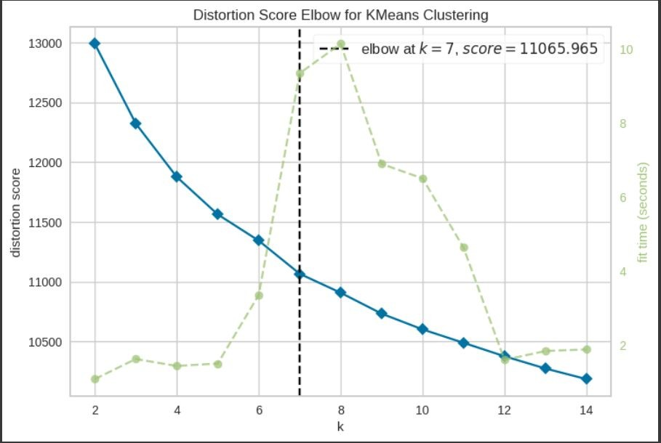
DATA VIsUALIZATION
/(AI)/(AI)/

Slide 20
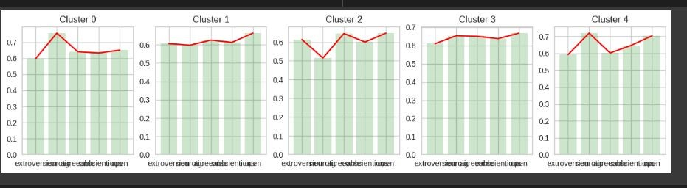
DATA VIsUALIZATION
/(AI)/(AI)/

Slide 21
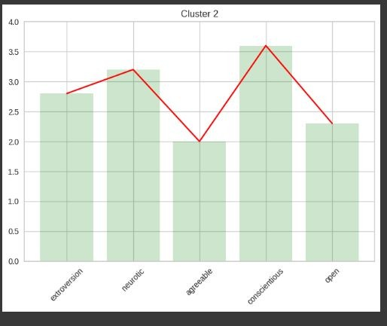
DATA VIsUALIZATION
/(AI)/(AI)/

Slide 22
05.
CONCLUsION
/(AI)

Slide 23
Accurate Personality Inference:
The Personality Prediction System, anchored in machine learning, demonstrates commendable accuracy in predicting individual personality traits, oﬀering a reliable and data-driven alternative to traditional methods.
Eﬃcient Model Selection:
Through rigorous model comparison and hyperparameter tuning, the Support Vector Machine emerges as the optimal choice, striking a balance between precision and recall while eﬃciently handling the complexities of personality prediction.
Practical Implications:
The system's robust performance, coupled with insights from data analysis, opens avenues for practical applications in diverse ﬁelds, including human resources, recommendation systems, and mental health assessments, marking a signiﬁcant stride in leveraging AI for a deeper understanding of human behavior.
/(AI)/(AI)/

Slide 24
REFERENCES
/(AI)
06.

Slide 25
REsOURCEs
Smart-Hire Personality Prediction Using ML, Isha Gupta;Manasvi Jain; Prashant Johri 2023 International Conference on Disruptive Technologies (ICDT), Year: 2023 Conference Paper, Publisher: IEEE
Framework for Implementation of Personality Inventory Model on Natural Language Processing with Personality Traits Analysis, P. William;Yogeesh N;Vishal M Tidake; Snehal Sumit Gondkar;Chetana. R; K. Vengatesan, 2023 International Conference on Intelligent Data Communication Technologies and Internet of Things (IDCIoT)
Data Mining Classiﬁcation Techniques to Assign Individual Personality Type and Predict Job Proﬁle, Mridul Sharma;Shruti Joshi; Soumya Sharma; Abhilasha Singh; Ritu Gupta, 2021 9th International Conference on Reliability, Infocom Technologies and Optimization (Trends and Future Directions) (ICRITO)
A
I)
RTIFICIAL INTELLIGENCE (A

Slide 26
ARTIFICIAL
INT (AI)
ELLIGENCE
THANK YOU
(AI)

